Slide 1

SATELLITE IMAGE CLASSIFICATION
Course: Introduction to Space Engineering – Final Project
Team Members:
Shifaa Khatib
Bashar Naser
Aseel Zatme

Slide 2
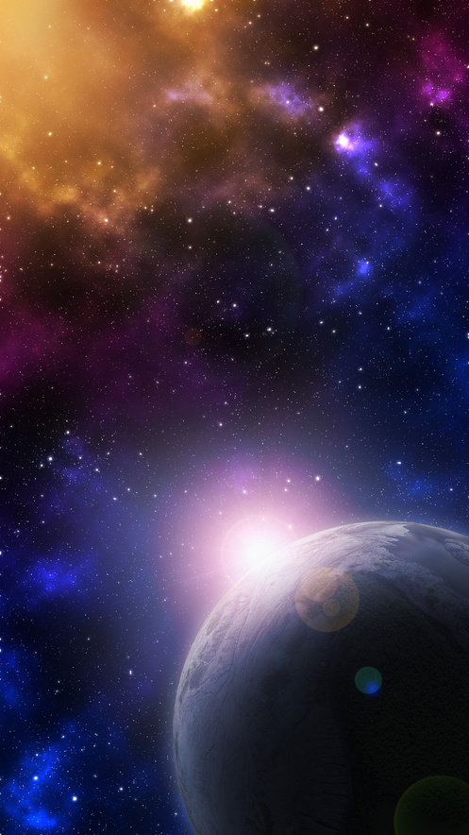
AGENDA
1
Motivation
5
Unified Pipeline
2
Dataset
6
Evaluation & Results
3
System Architecture
7
Conclusion & Future Work
4
Model Implementation

Slide 3
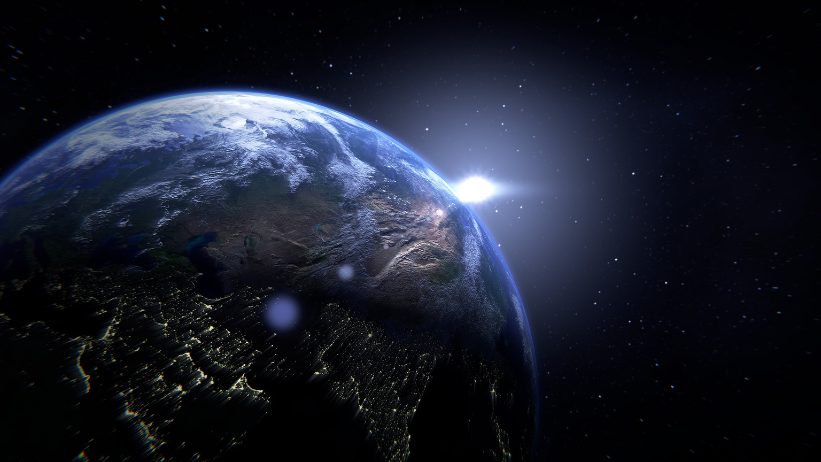
WHY DO WE NEED STELLITE IMAGE CLASSIFICATION❓
1.📡 Limited Transmission Bandwidth
Satellites can’t send every captured image to Earth due to communication limits.
2.🔋 Constrained Onboard Resources
Spacecraft have very limited power and processing capabilities.
3.📷 Many Satellite Images Are Unusable
Blurry, overexposed, black-space, or sun-glared images waste bandwidth.
We Must Prioritize “Good” Satellite Images
Smart classification enables satellites to send only valuable visual data.

Slide 4
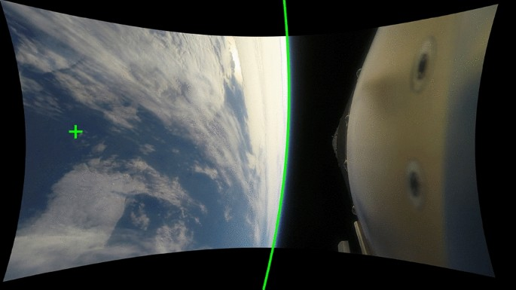
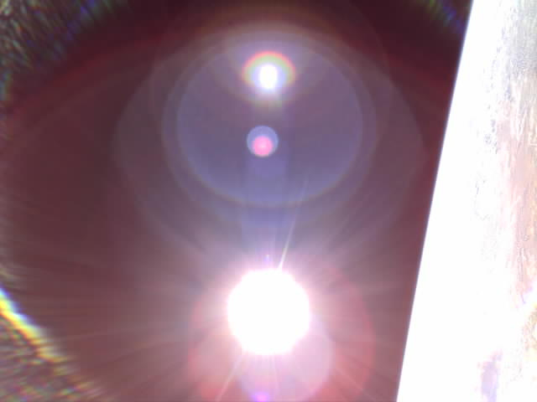


PROJECT GOAL-
Build an Onboard Satellite Image Classification System:
A lightweight, modular system that can:
01
Detect the Horizon:
02
Detect Flares or Sunburns
Evaluate Image Quality
Classify images as Good or Bad for scientific/operational use.
03

Slide 5

DATASET OVERVIEW
🌍Source: Real Satellite Imagery from BIRDS-3 & BIRDS-4 Missions
Collected by 1U CubeSats launched from the International Space Station.
Captured in Low Earth Orbit at ~400 km altitude.
Dataset is publicly available on Mendeley Data for academic research.
🧹 Data Preparation and Augmentation:
Images resized to 224×224 pixels, Split into 3 classification tasks:
Horizon Detection (horizon / no_horizon).
Flare Detection (flare / no_flare).
Quality Evaluation (good / bad).
Applied data augmentation:
Rotation, flipping, brightness/contrast adjustments.
-Helps simulate noise and improve robustness.

Slide 6

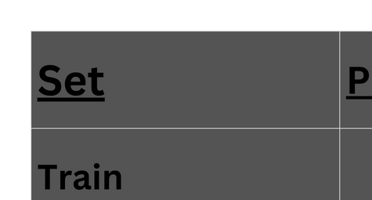

DATASET OVERVIEW
We split the dataset into three subsets for each classification task:

Slide 7
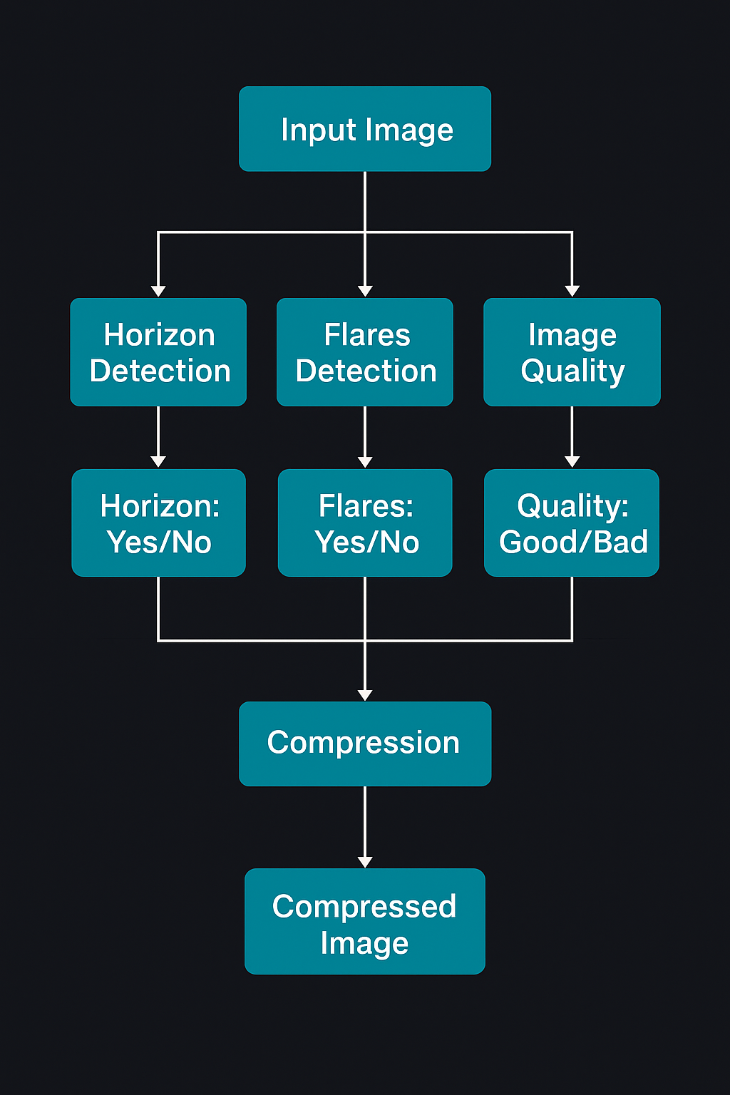
Salford & Co.
🔧 SYSTEM ARCHITECTURE
“The architecture we designed consists of a pipeline with 3 main modules:
First, the system checks if the image contains the Earth's horizon.
Then, it detects whether there’s a sun flare or glare.
After that, we evaluate the overall quality of the image and classify it as good or bad. If the image is considered good, it gets compressed using a custom JPEG-based compressor before being marked for transmission.”

Slide 8
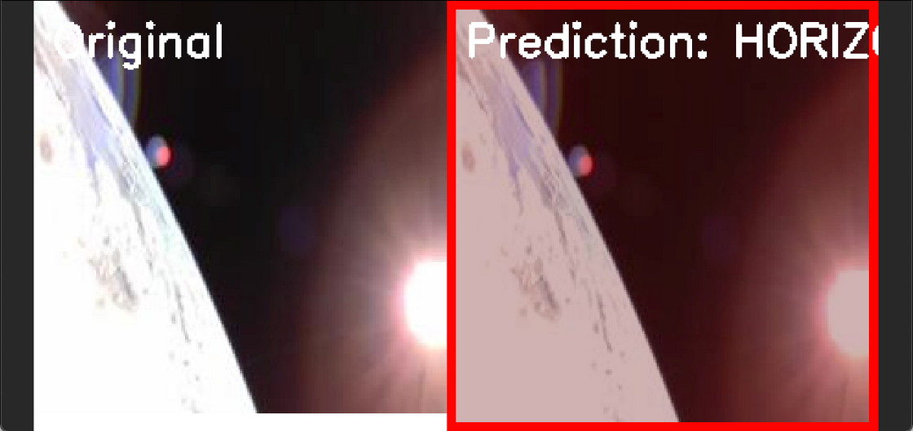
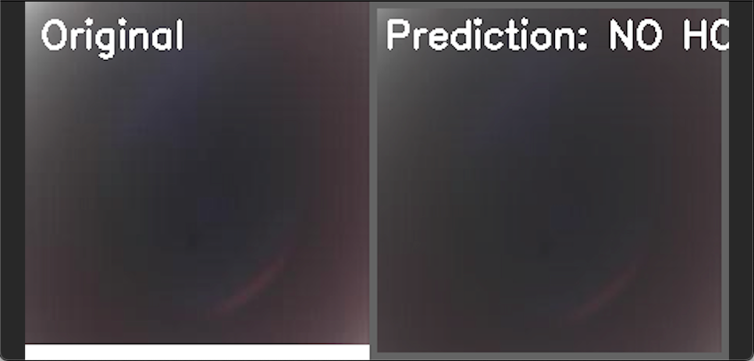
Horizon Detection Model
🧠 Model Overview:
Type: Binary image classifier using CNN
Input: 224×224 satellite image
Output: horizon / no_horizon
Training Data:
Labeled images from horizon/ and no_horizon/ folders
Augmentation: Rotation, brightness variation, noise

Slide 9
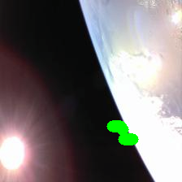
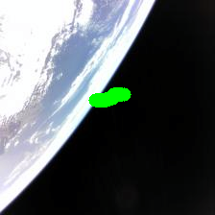
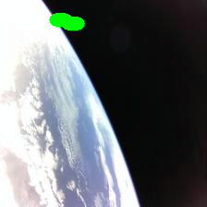
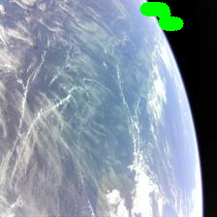
Horizon Detection Model
The green mark shows where the model recognized the horizon curvature.
This confirms the CNN model’s ability to detect Earth boundaries, even with glare and lighting variations.

Slide 10
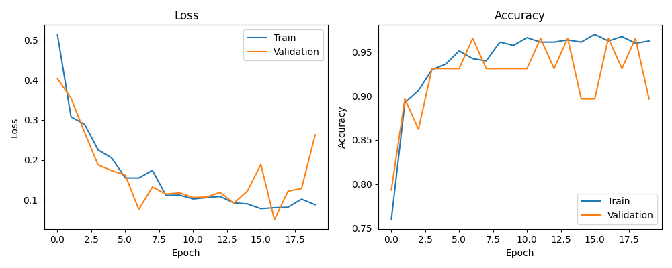
Horizon Detection – Training Results
🔹 Left Graph: Loss vs. Epochs
Training loss steadily decreases → model learning is effective
Validation loss fluctuates slightly but remains low
No sign of severe overfitting
🔹Right Graph: Accuracy vs. Epochs
Training accuracy reaches >97%
Validation accuracy remains stable, mostly above 95%
Best performance around epoch 10–18

Slide 11
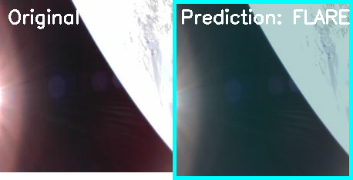
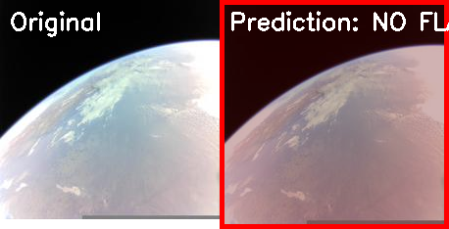
Flare Detection Model
Purpose: Detect the presence of sun flares or glare artifacts that reduce image usability.
🧠 Model Overview:
Type: Binary CNN classifier
Input: 224×224 satellite image
Output: flare / no_flare
Training Data:
Labeled folders: flare/ and no_flare

Slide 12
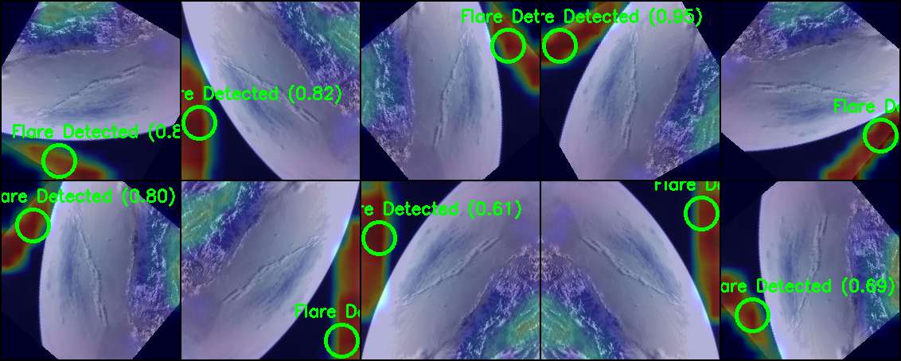
Flare Detection – Prediction Examples
model’s flare predictions, These images contain visual distortions caused by sunlight — often difficult to detect consistently.

Slide 13
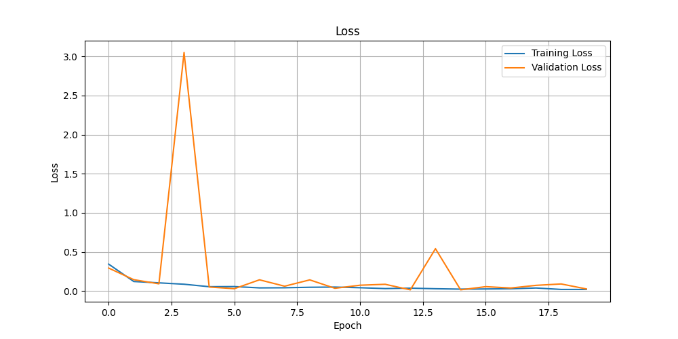
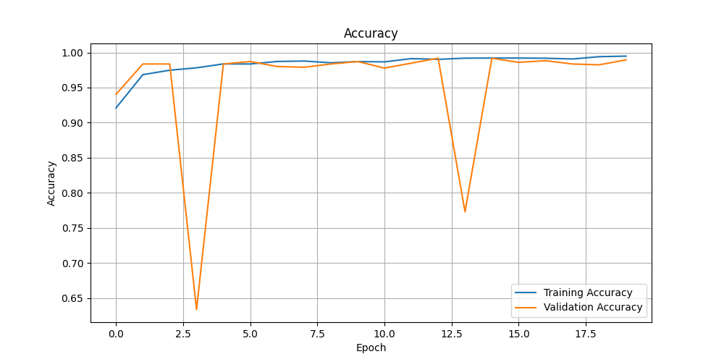
Flare Detection – Training Results

Slide 14
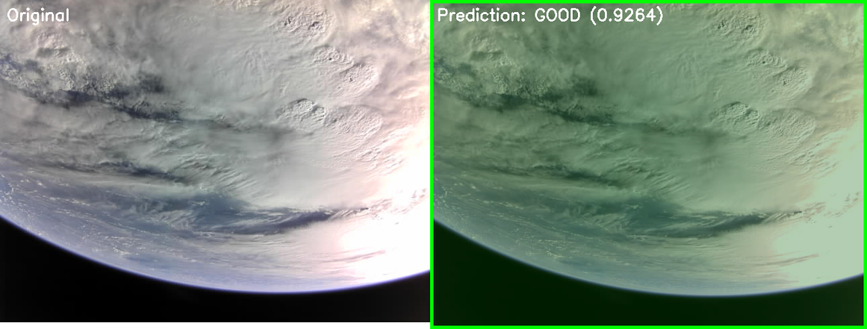
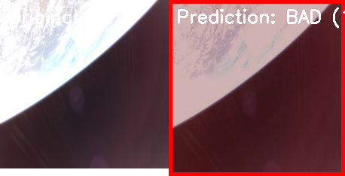
Quality Model
Purpose: Decide whether a satellite image is usable (good) or unusable (bad) based on:
Sharpness
Exposure (too dark / too bright)
Visible content (Earth vs. empty space)
🧠 Model Overview:
Type: Binary CNN classifier
- Input: 224×224 satellite image
-Output: good / bad
Training Data: Manually labeled: good/ and bad
Criteria:
- Good: clear horizon or Earth features
- Bad: overexposed, blurred, empty, sun-damaged

Slide 15
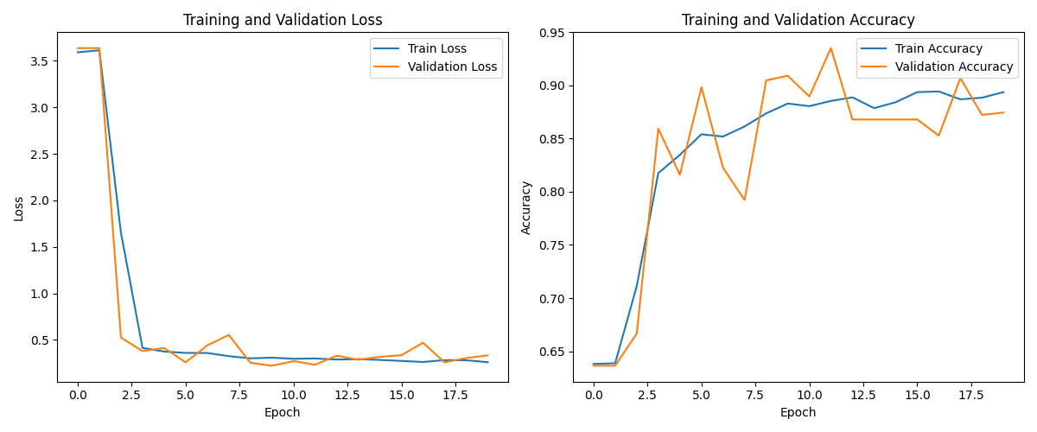
Quality Model- Training results

Slide 16
Unified Classification Pipeline
🛰️ Purpose:
Combine all three models into a single, end-to-end decision system that:
Classifies horizon, flare, and quality
Compresses good images
Returns a unified, structured output
🔗 Pipeline Flow:
📥 Input: Satellite image
✅ Horizon Detection
☀️ Flare Detection
📷 Image Quality Classification
🗜️ If Quality = “Good” → Compress image to ≤100 KB
📤 Output: JSON file + optional compressed image

Slide 17
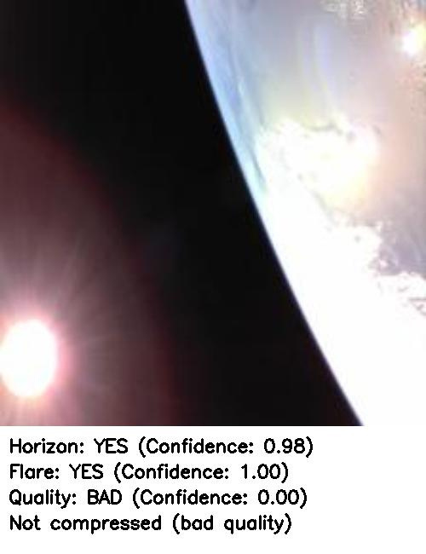
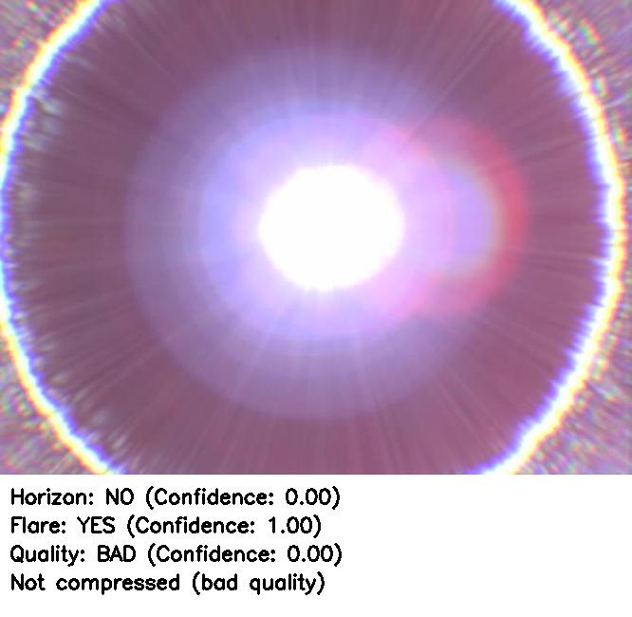
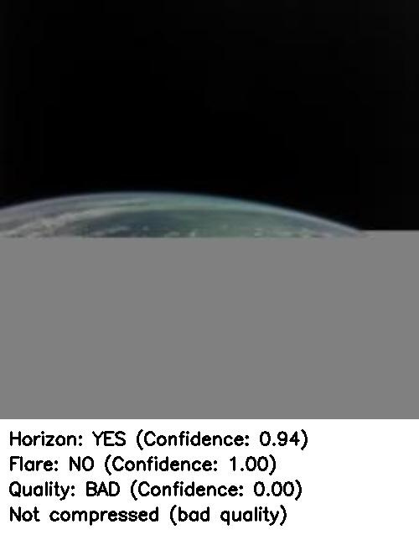
Unified Pipeline – Inference Examples:

Slide 18
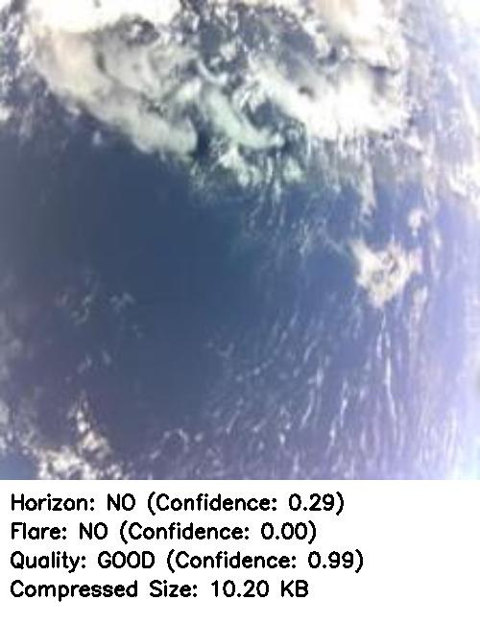
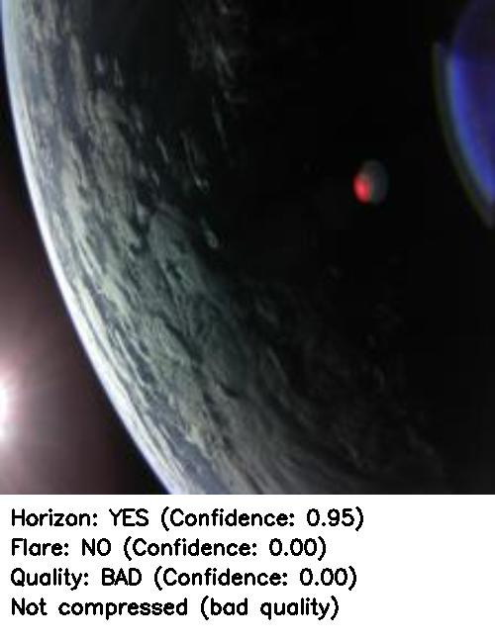
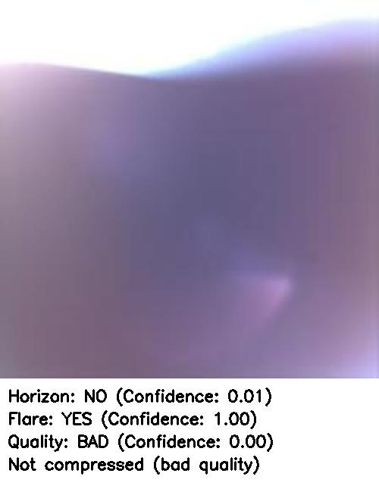
Unified Pipeline – Inference Examples:

Slide 19
CONCLUSION
🎯 What We Achieved?
Developed a modular image classification system for satellite images
Implemented three CNN models to detect:
Horizon
Flare (sun glare)
Overall Image Quality
Built a unified pipeline for real-time decision-making
Integrated adaptive image compression for “good” images
Achieved high accuracy and reliable performance on real CubeSat imagery

Slide 20

FUTURE WORK
1
Expand Dataset and Labeling
Add images from:
Other CubeSat missions, public satellite repositories (e.g., Sentinel, Landsat)
Simulated flare conditions, night-time, or atmospheric interference
Use self-supervised learning to leverage unlabeled data
2
Beyond Binary Classification
Use multi-label classifiers for joint horizon + flare + quality prediction
Explore semantic segmentation to locate Earth, space, and flares precisely
Train model to detect specific features: oceans, continents, cities, clouds

Slide 21

THANK YOU

